Slide 1
MINI PROJECT
Face Recognition Attendance System using Python
T.Y CST SEM VI 2021-22
DEPARTMENT OF TECHNOLOGY,
SHIVAJI UNIVERSIT, KOLHAPUR

Slide 2
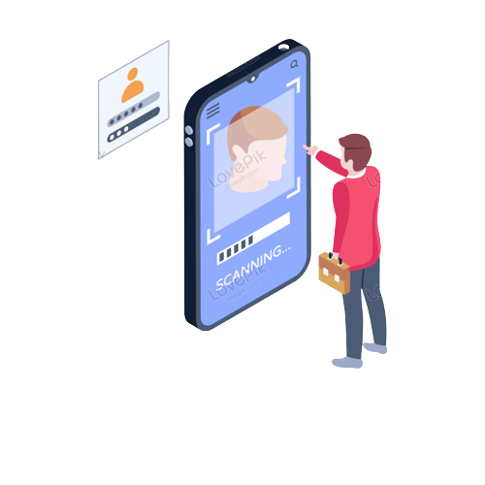
Contents
What is FACE RECOGNITION?
Implementation SYSTEM DESIGN
Why is it nessesary?
ADVANTAGES & DISADVANTAGES CONCLUSION

Slide 3

What is FACE RECOGNITION?
A facial recognition system is a technology capable of identifying or verifying a person from a digital image or a video frame from a video source. There are multiple methods in which facial recognition systems work, but in general, they work by comparing selected facial features from given image with faces within a database

Slide 4
The main objective
system
of this
of face
automated detection
attendance
recognition is to present face recognition in a real time environment, to see and mark the attendance on the daily basis to keep track of their presence. The system will mark and record the attendance in any environment. This system is automated & accordingly the
attendance will be accuracy to great
marked, improving the extend and finally the
attendance reprt will be generated,

Slide 5
Implementation:-
The proposed model is based on face recognition mechanism. The basic methodology presents whenever a student enters the class and comes across the camera module of the system his image is captured in the system and is recognized and validate if he is student of the class. If recognized then his attendance is automatically marked via post processing of the system. The system architecture consists of various stages and steps ranging between creating dataset and updating of the database.

Slide 6

OVERVIEW
face Recognition systems have the ability to execute tasks naturally associated with human intelligence, like machine learning algorithm.
Technology
Dlib Library
Open CV
Python GUI
Python libraries
Face Recognition Algorithm

Slide 7

REQUIREMENTS
Software Requirements
Windows 7, 8, 10
Visual studio 2022
VS Code or PyCharm Community Edition
Hardware Components
Processor – i5 Hard Disk (ROM)
Memory (RAM)– 4GB
Camera with good mega pixels.

Slide 8
Staps Of Working
Train Image
Run Main.py
Recognition Face
Mark Attendance
Match Image

Slide 9
ADVANTAGES
It is Easy to use in any case.
The camera price should go down. This system is convenient.
Face recognition is more user friendly.
It is an inexpensive technique of identification. Social acceptability.
Can prevents all kinds of fraud.

Slide 10
DISADVANTAGES
The face recognition attendance system can't tell the difference between identical twins.
Privacy concerns related to facial recognition. Technology is not mature yet.
Can take away freedom and fun from people. Sensitive data may stolen by hackers.
Lack of regulation in facial recognition system.

Slide 11
CONCLUSION
The purpose of reducing the errors that occur in the traditional attendance taking system has been achieved by implementing this automated attendance system. By using this technology we can overcome the problems of fake attendance.
We can save time and efficiency is more. Summing it up, every new facial recognition technology represents huge perspectives and promises for the future evolution
Team Members: Mahamadabrar Dastagir Maneri (41), Aishwarya Sandip Patil (57), Amisha Ashok Patil (58)

